Slide 1
Beats Analysis
Hector Orozco

Slide 2
Theta Monoaural

Slide 3
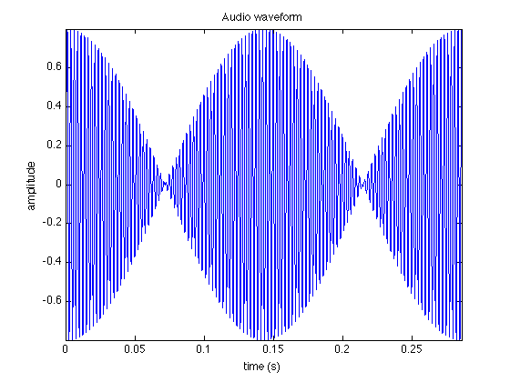
Cycle
Two cycles of the beat created with both constructive and destructive interference between the pure tones

Slide 4
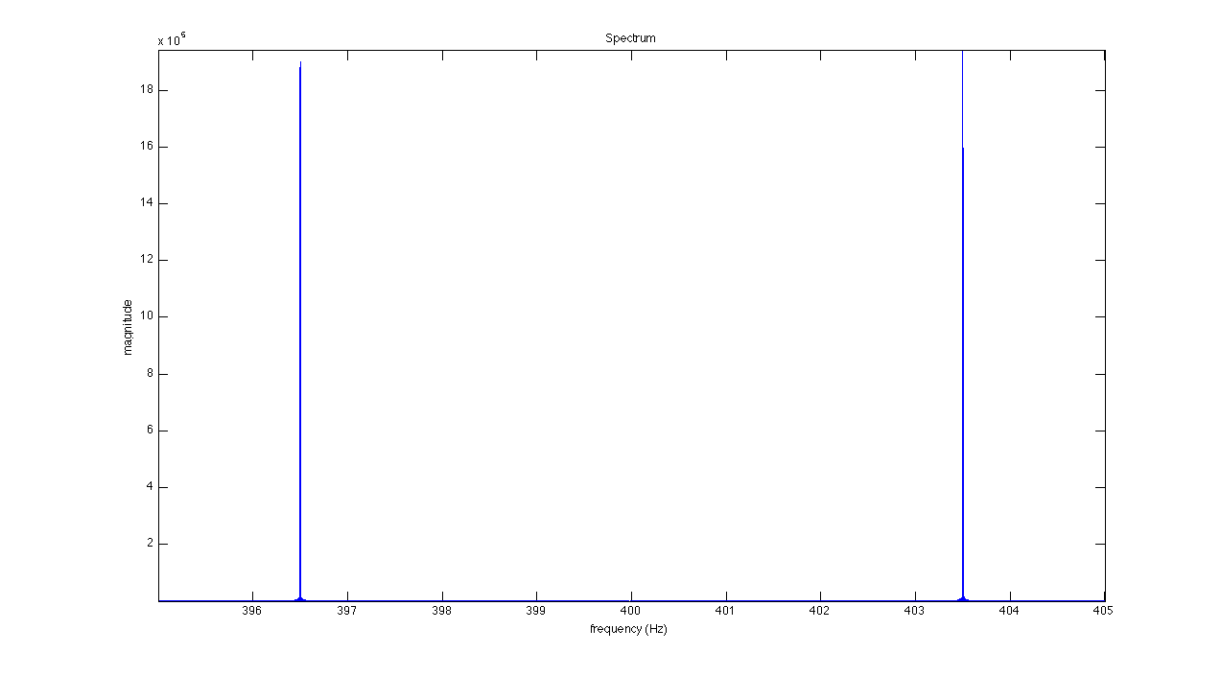
FFT

Slide 5
FFT
Close-up of the FFT (there were no other peaks)
Consistent with what we knew (stimulus created by the mix down of two pure tones: 396.5Hz and 403.5Hz)

Slide 6
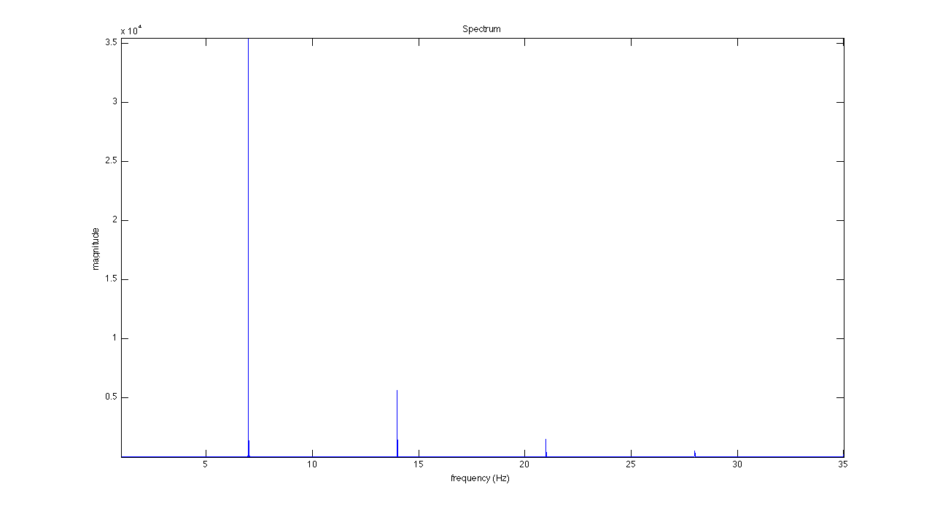
FFT of the HT

Slide 7
FFT of the HT
Close-up of the FFT of the HT (there were no other major peaks; the peaks represent the harmonics of the frequency of the beat)
Consistent with what we knew (the beat is found in the envelope with a frequency of 7Hz and its harmonics: 14, 21…)

Slide 8
Gamma Monoaural

Slide 9
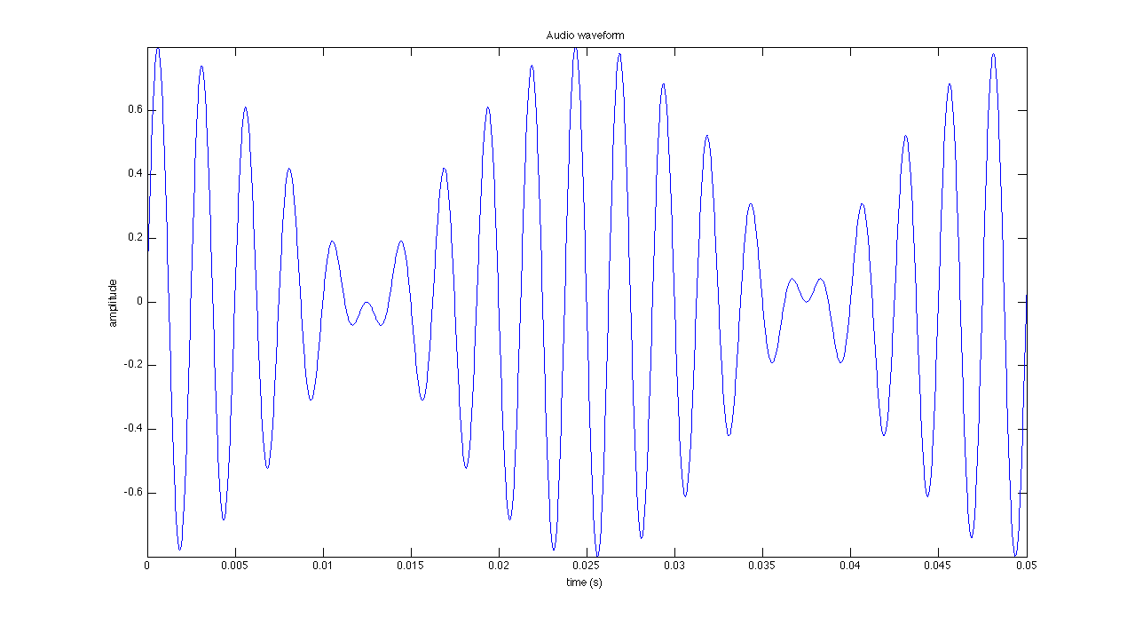
Cycle
Two cycles of the beat created with both constructive and destructive interference between the pure tones

Slide 10
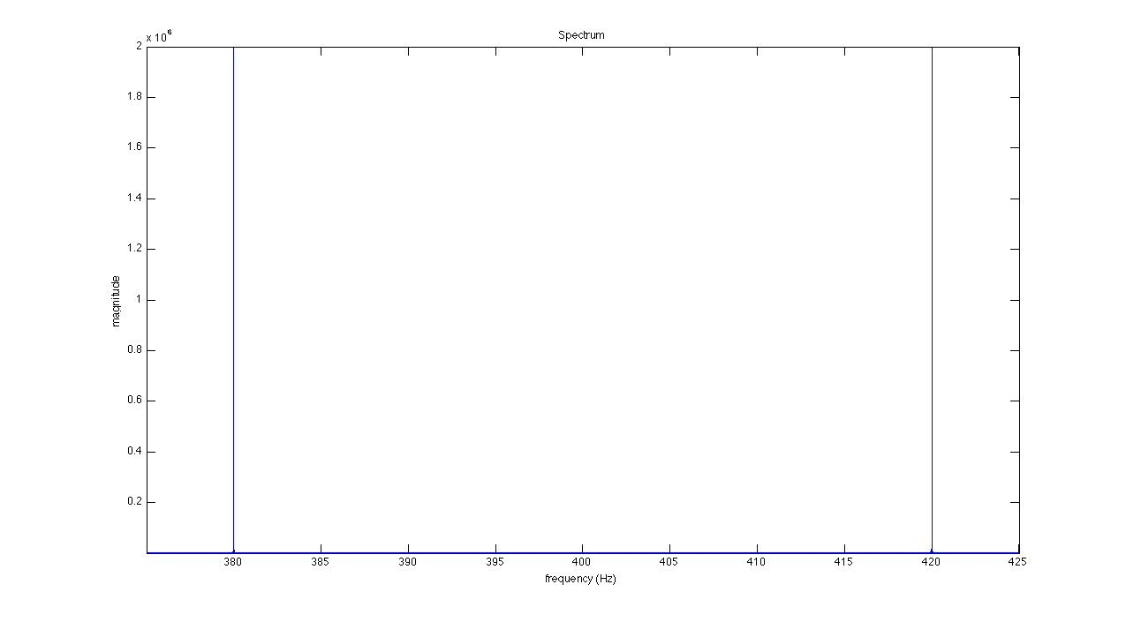
FFT

Slide 11
FFT
Close-up of the FFT (there were no other peaks)
Consistent with what we knew (stimulus created by the mix down of two pure tones: 380Hz and 420Hz)

Slide 12
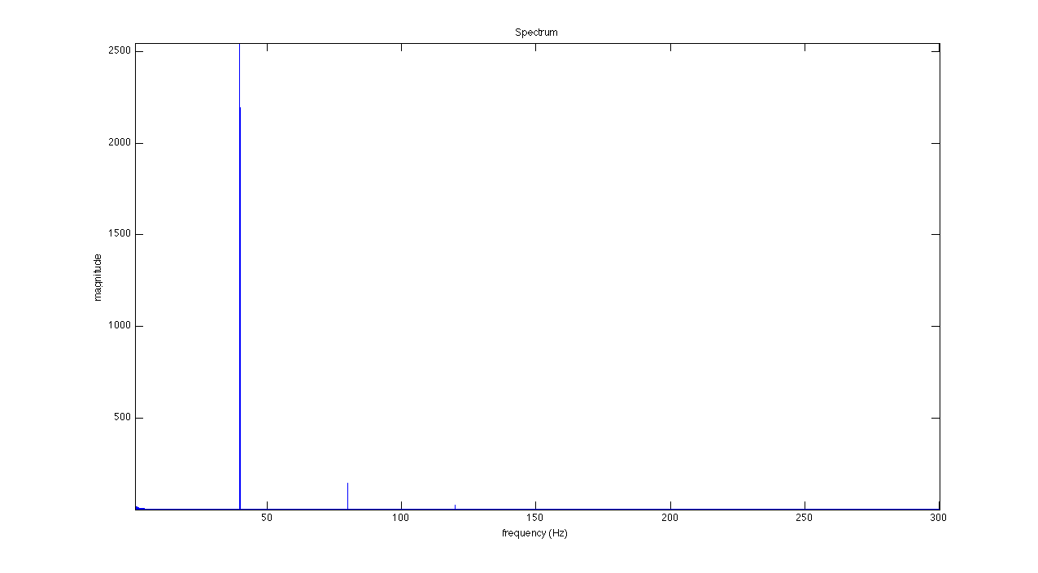
FFT of HT

Slide 13
FFT of HT
Close-up of the FFT of the HT (there were no other major peaks; the peaks represent the harmonics of the frequency of the beat)
Consistent with what we knew (the beat is found in the envelope with a frequency of 40Hz and its harmonics: 80, 120…)

Slide 14
Theta Binaural

Slide 15
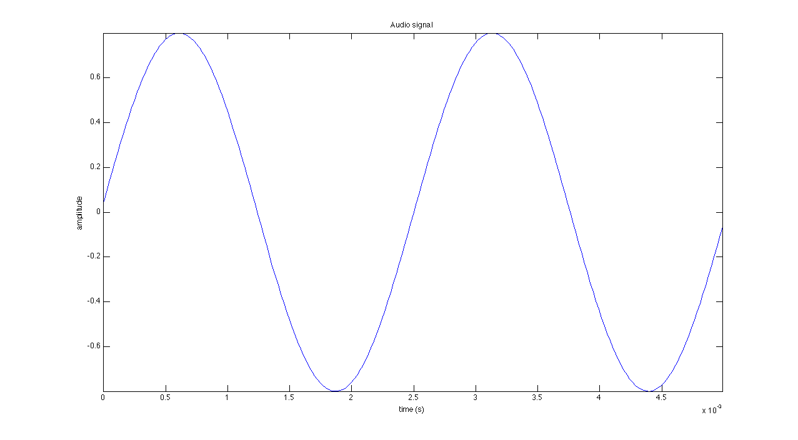
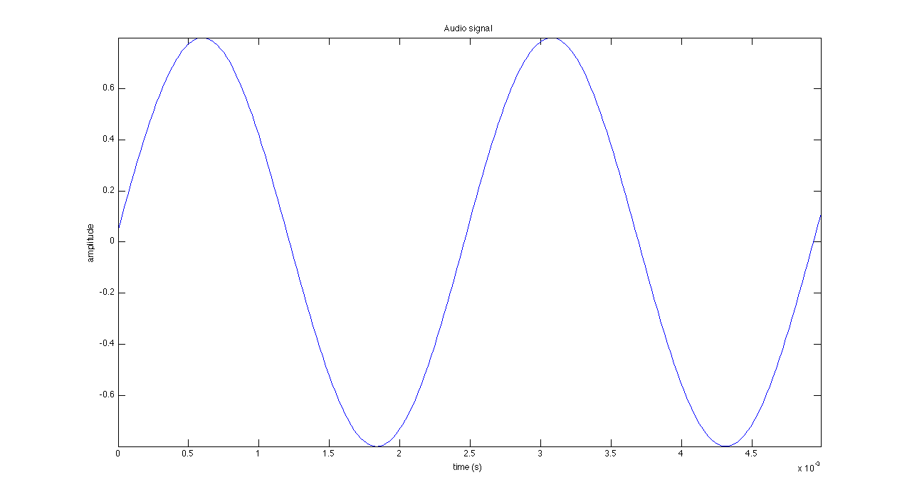
Cycle
Two cycles of the pure tones (upper one: left)

Slide 16
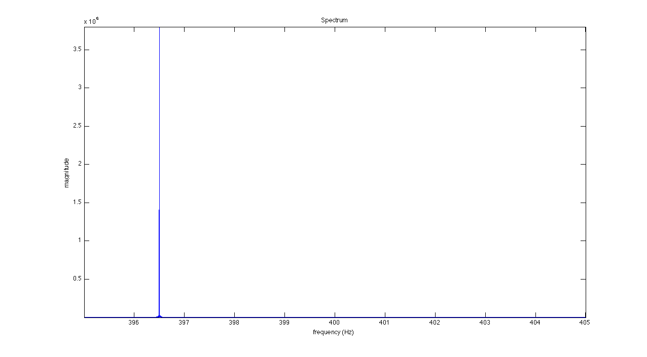
FFT (Left)

Slide 17
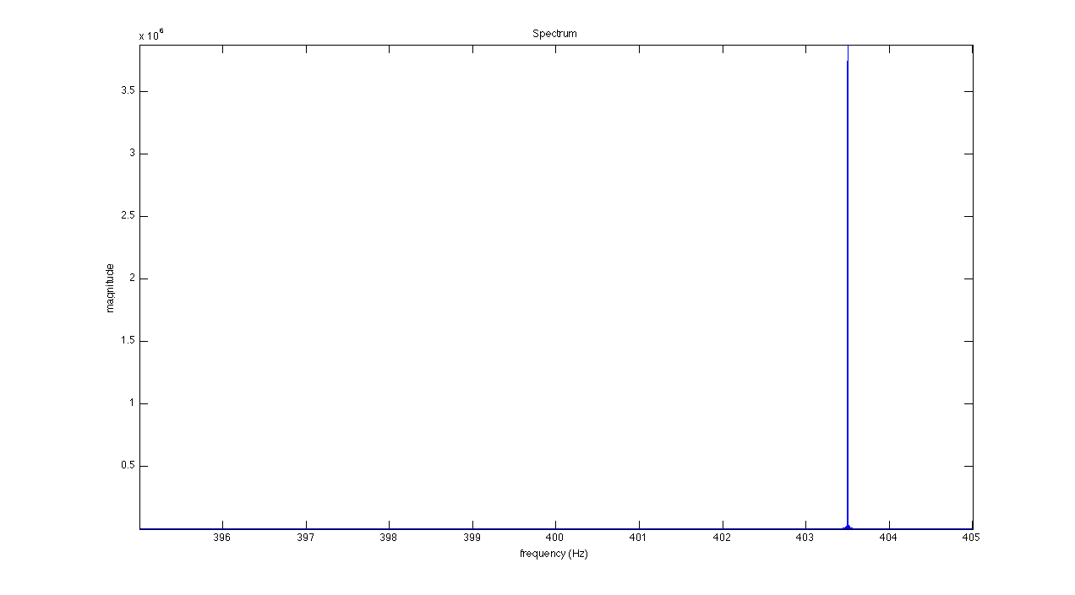
FFT (Right)

Slide 18
FFT
Close-up of the FFT (there were no other peaks)
Consistent with what we knew (stimulus created by stereo channels of separate pure tones with frequencies: 396.5Hz and 403.5Hz)

Slide 19
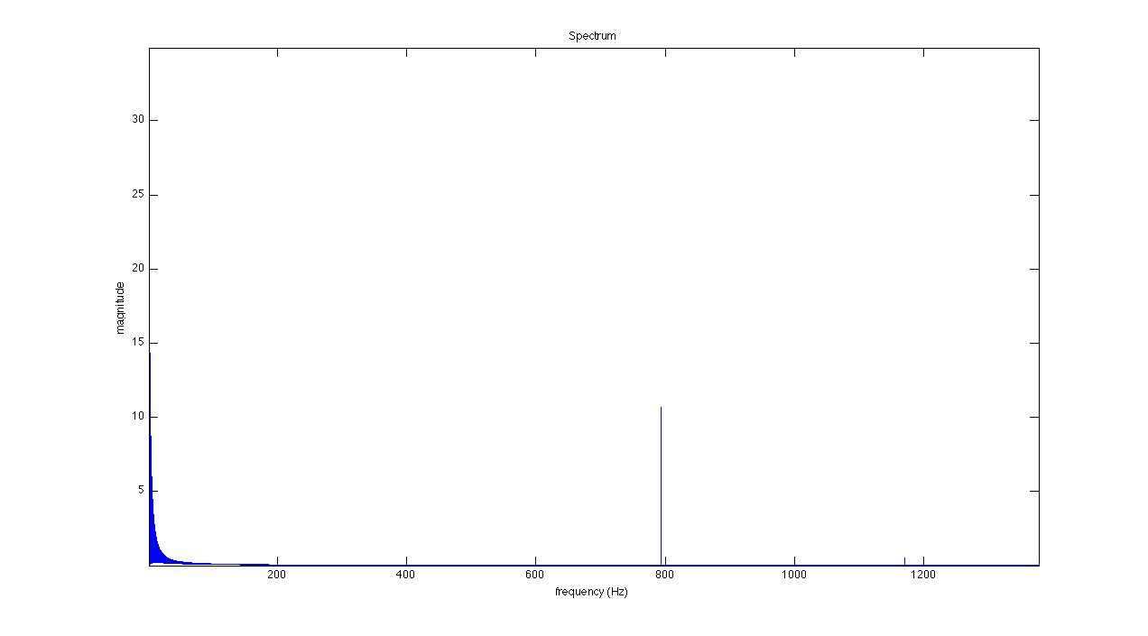
FFT of HT (Left)

Slide 20
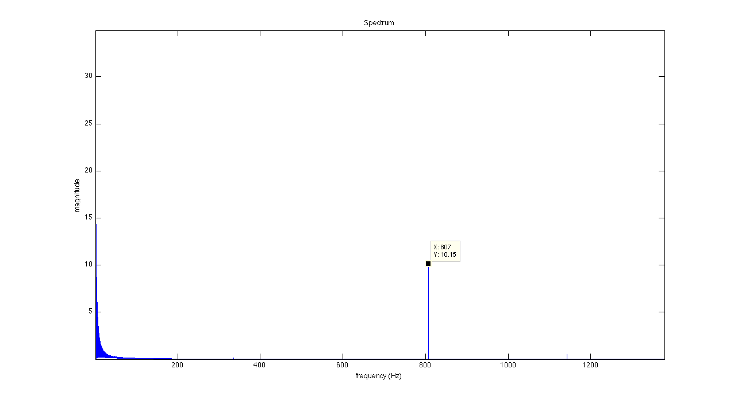
FFT of HT (Right)

Slide 21
FFT of HT
Close-up of the FFT of the HT (there were no other major peaks)
Not really sure what is happening here; the peaks represent the first harmonic of each pure tone and there is a small subsequent peak which I have no idea as to what it could be.

Slide 22
Gamma Binaural

Slide 23
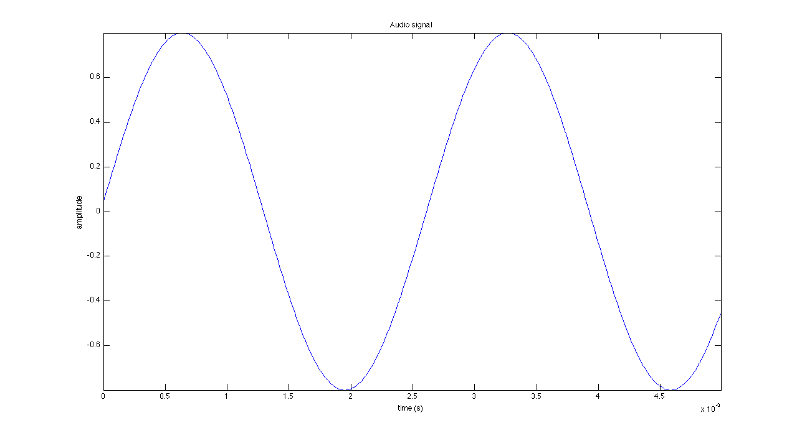
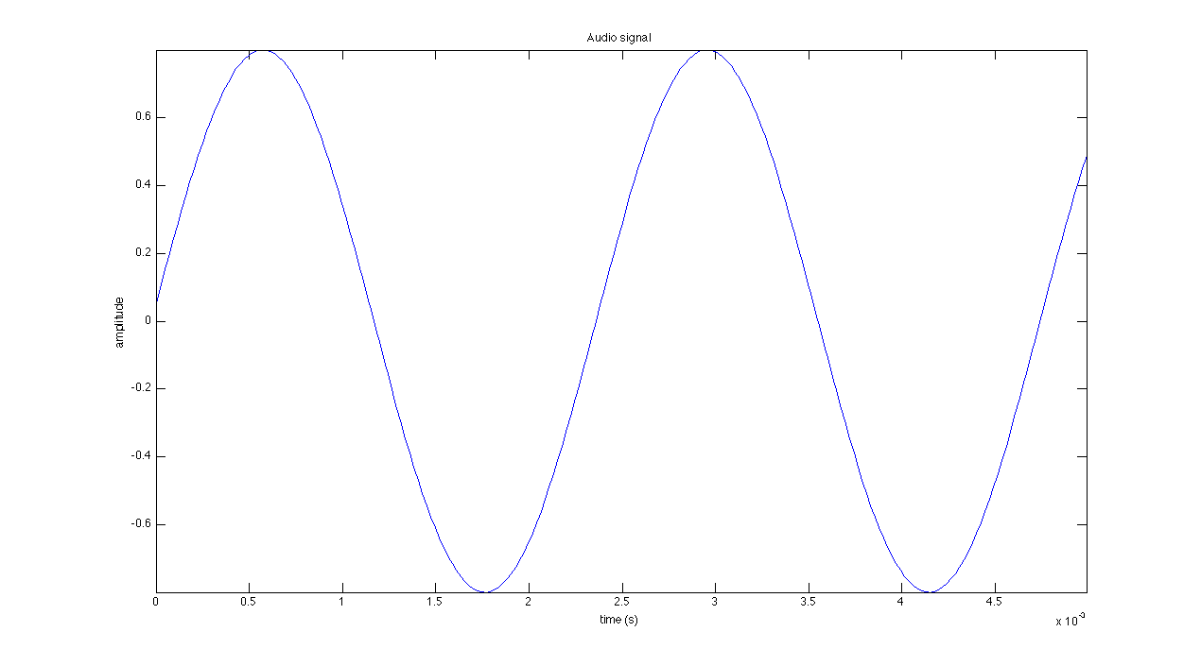
Cycles
Two cycles of the pure tones (upper one: left)

Slide 24
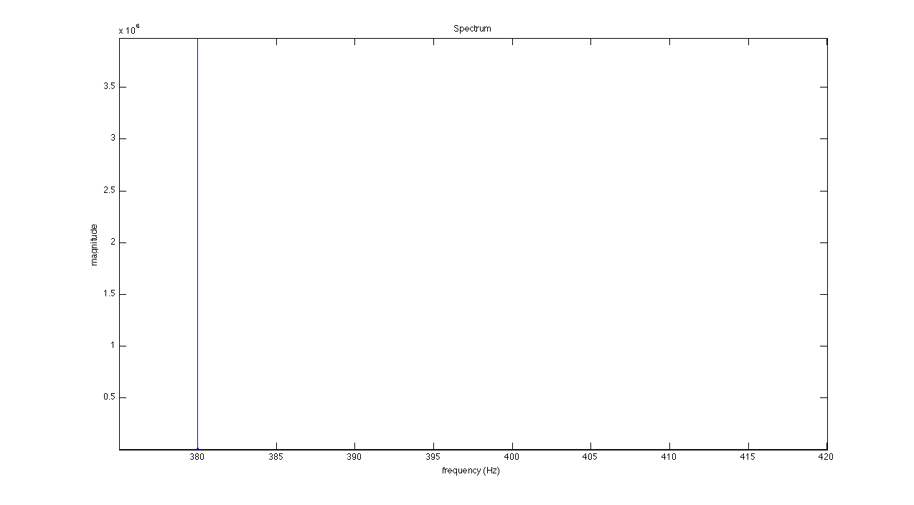
FFT (Left)

Slide 25
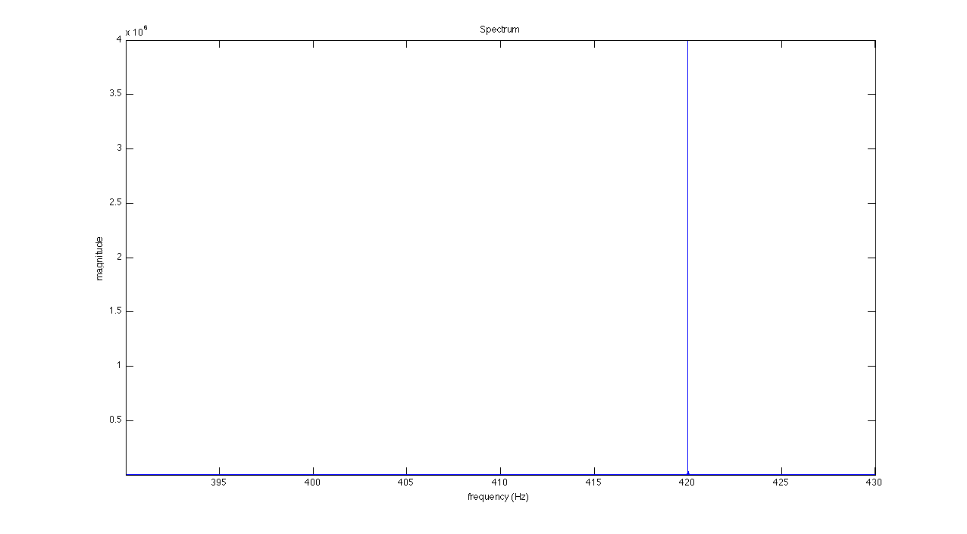
FFT (Right)

Slide 26
FFT
Close-up of the FFT (there were no other peaks)
Consistent with what we knew (stimulus created by stereo channels of separate pure tones with frequencies: 380Hz and 420Hz)

Slide 27
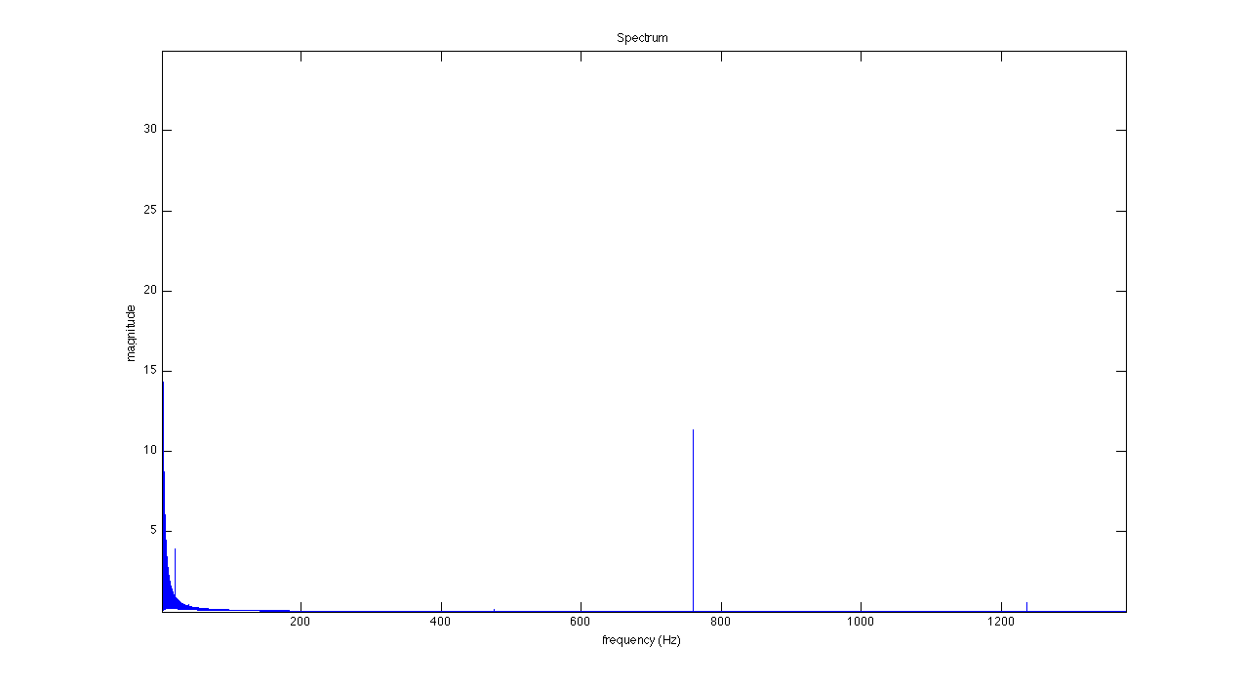
FFT of HT (Left)

Slide 28
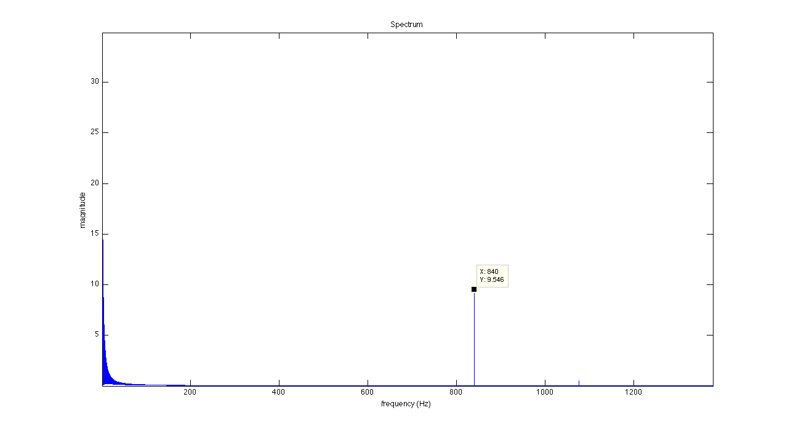
FFT of HT (Right)

Slide 29
FFT of HT
Close-up of the FFT of the HT (there were no other major peaks)
Not really sure what is happening here; the peaks represent the first harmonic of each pure tone and there is a small subsequent peak which I have no idea as to what it could be.

